Slide 1
The Library app for the library professional:
The library professional of today needs an application that can handle a few different functions that relates to both the library patron, their records and keeping a track of items in the collection. This means that an app that has functionality that can edit member records as well as item records is required. Thankfully that is exactly what this app does. The main functions being:
The first feature is a landing menu that allows the user to navigate the program.
Using a class feature to let the library professional create instances of new members and include biographical and required information for membership.
The third feature is the ability for the library professional to determine how many days are left on a borrowed item before it is overdue or even determining that the item is already overdue.
The fourth feature utlises a dictionary to discover if the library offers a particular service and whether that service requires a booking, is free or may cost.
The fifth feature is an exit feature that exits the program based off an input of “4”.
The aim of this app is to help libraries streamline their services and provide a seamless patron experience.

Slide 2
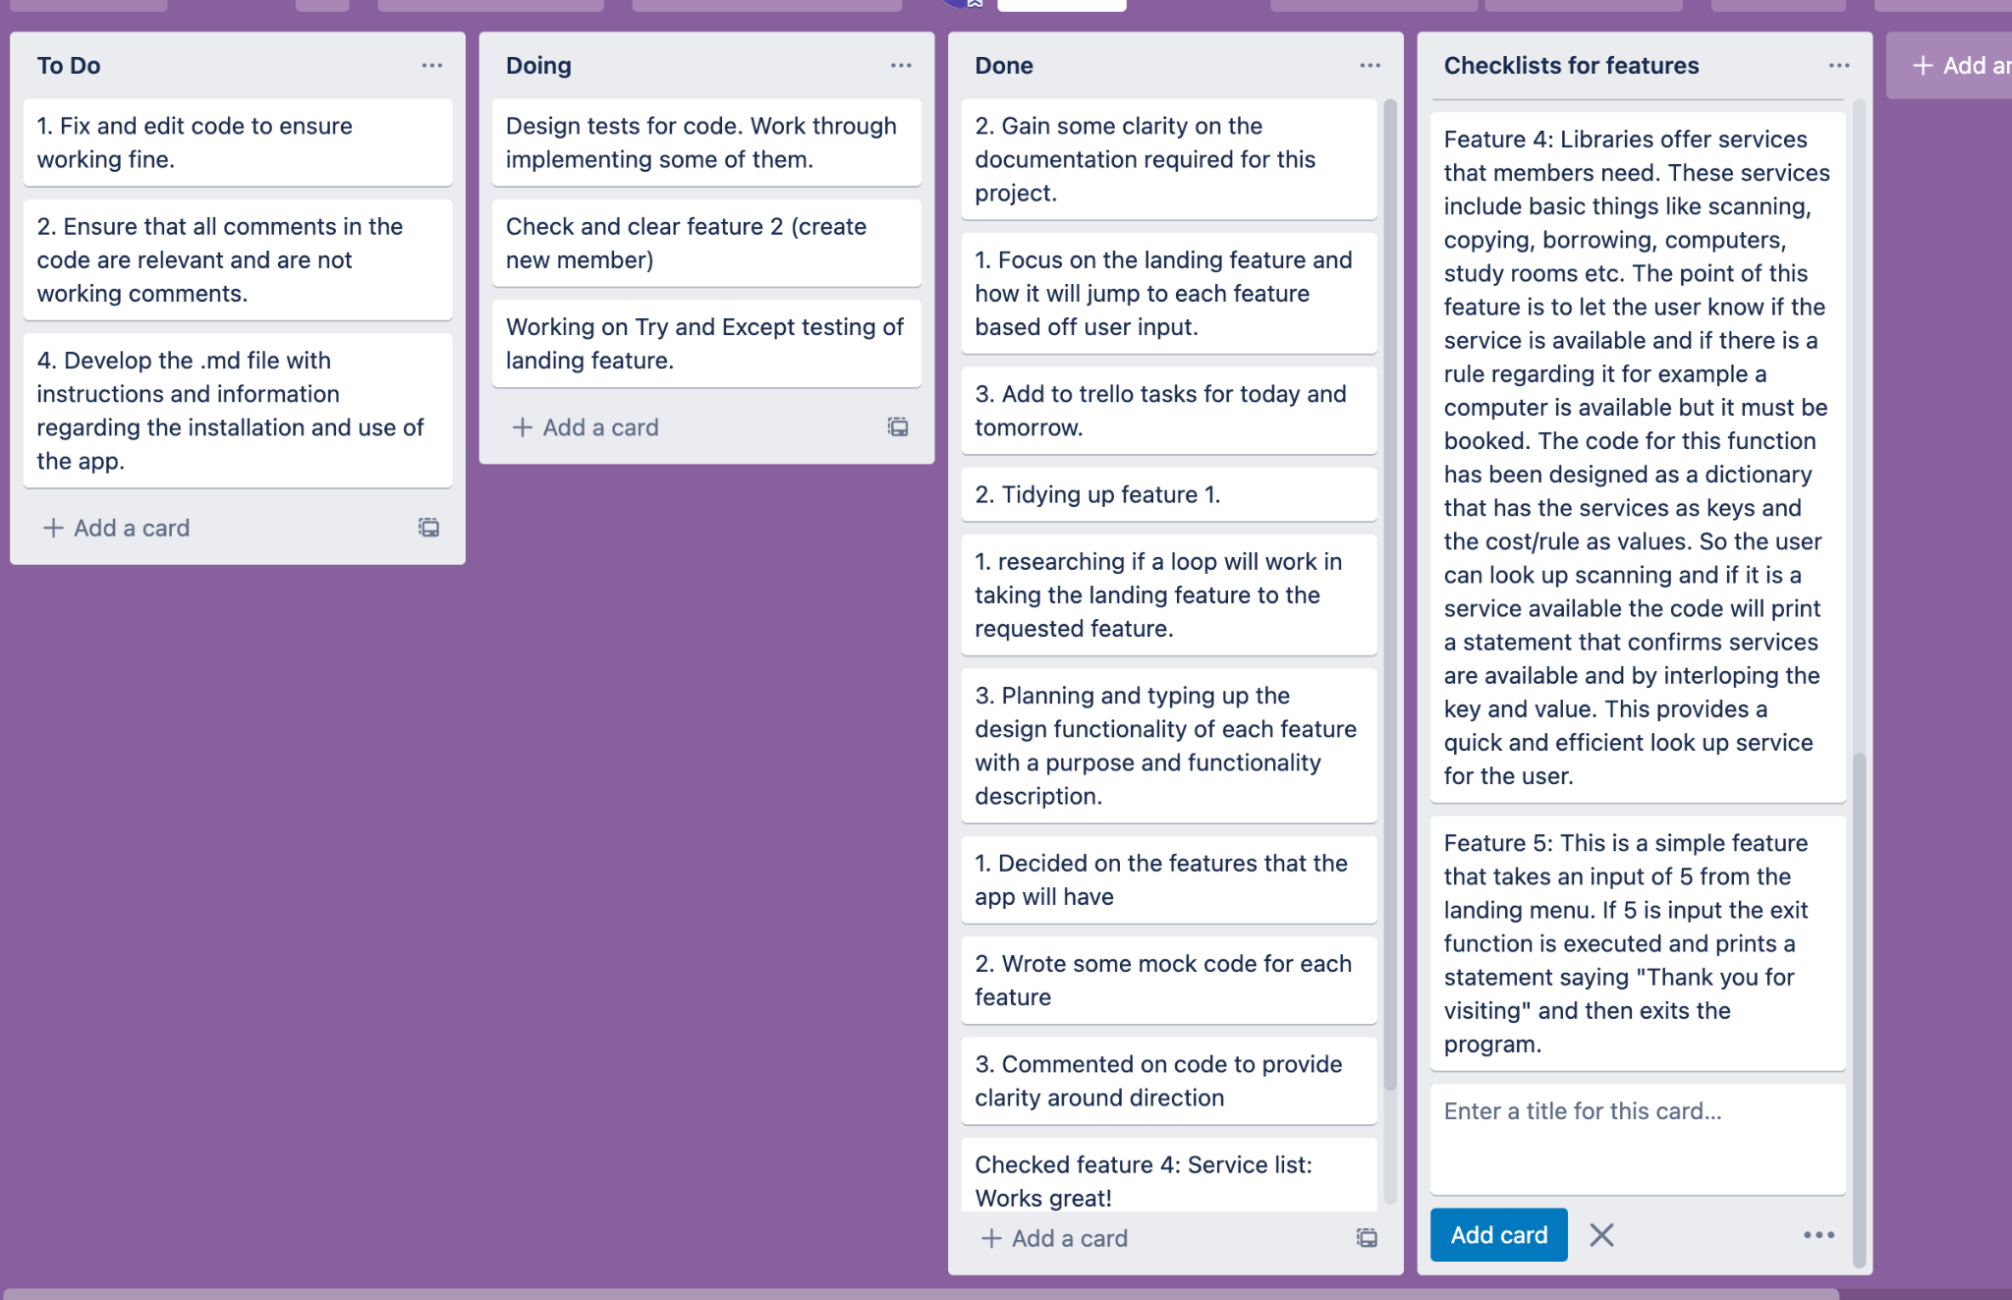
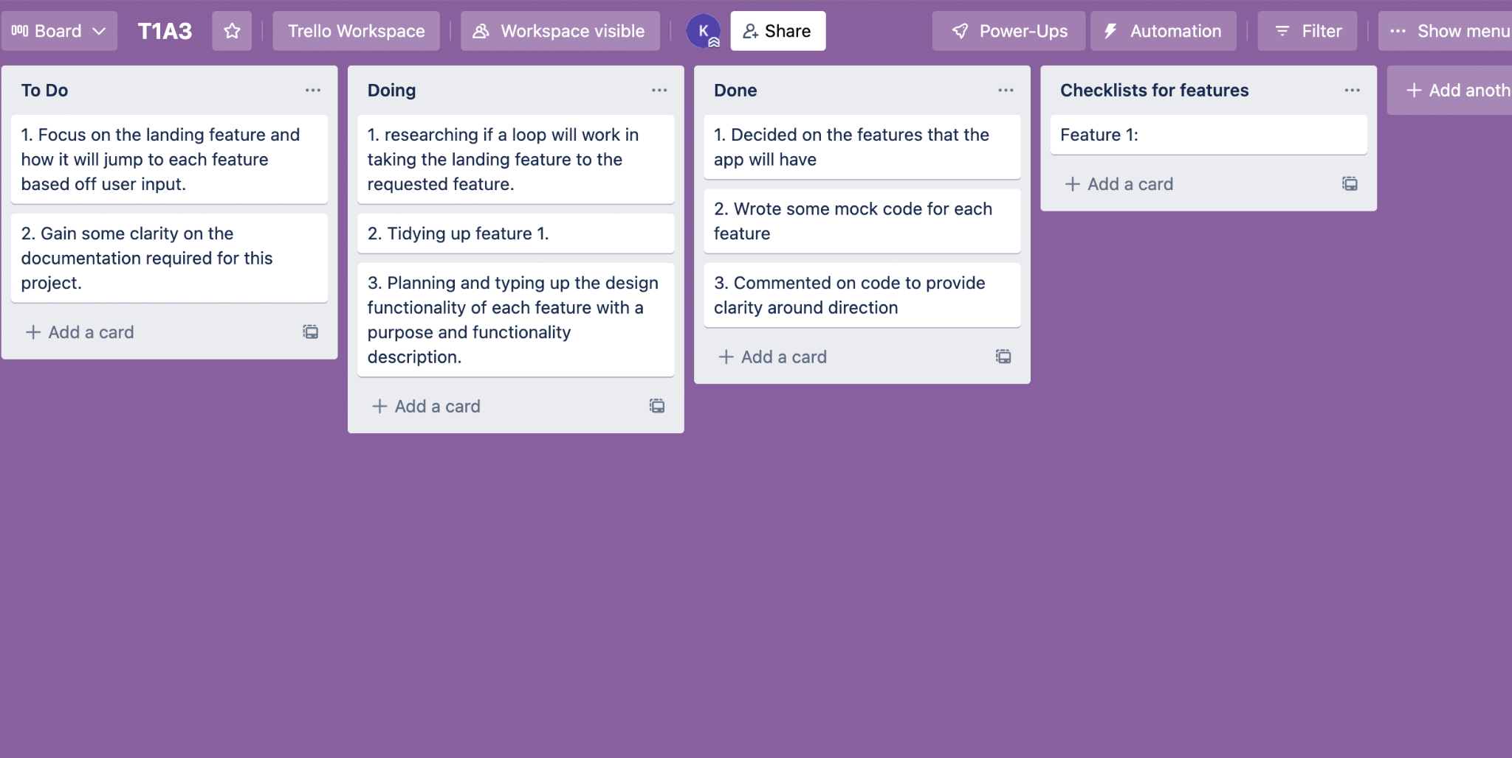
The project and tracking: Trello
To ensure the project remained on track and was able to be managed effectively Trello was introduced to the team. Trello has allowed us to manage, track and implement design changes and tasks in an efficient and productive manner.
https://trello.com/b/l32oUiwY/t1a3

Slide 3
Structure:
The app is designed to start with a landing menu that then takes the user to their desired function:
Landing Menu
Create Member
Check overdues
Check services
Exit

Slide 4
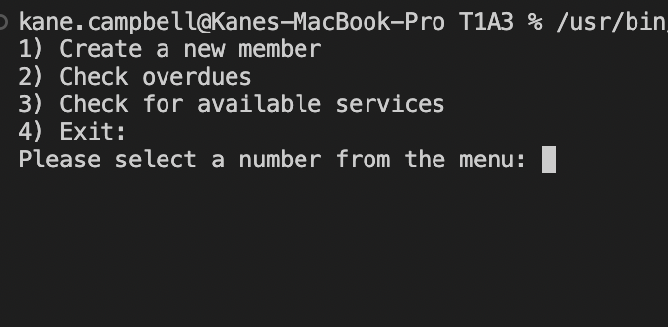
Feature 1:
The landing menu is a function designed to give the user options on how to use the app.

Slide 5
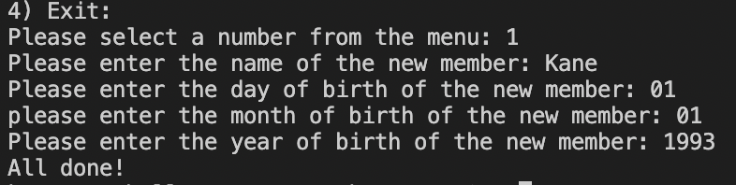
Feature 2:
Designed to let the library worker create a new member and include information such as a name and date of birth.

Slide 6
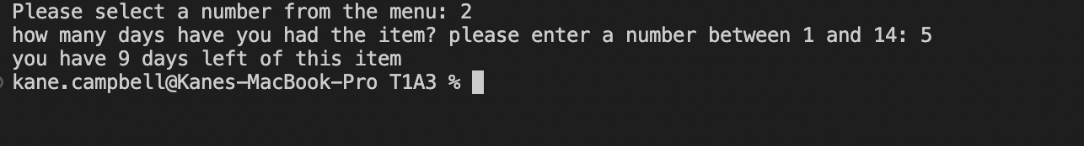
Feature 3:
This feature does the brilliant task of letting a patron check if the item they have borrowed is overdue or has a certain amount of days left.

Slide 7
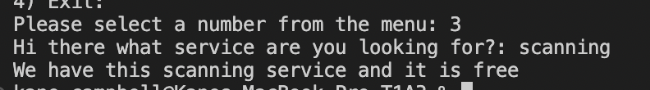
Feature 4:
A library has many different services that have requirements about their use such as cost, bookable and free. A patron or worker can now input the service they wish to have and the app will return a result letting them know if the library has it or not.

Slide 8
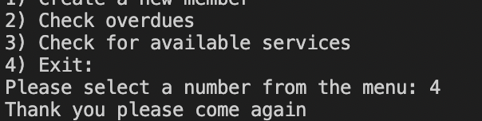
Feature 5:
The exit feature is designed to close and end the program.

Slide 9
Test 1:
The first of the two tests that has been put in place is one that will test the running of the landing menu and its ability to error handle number entries outside of the menu number range.
The test will run as:
Run app
Enter 6 which falls outside the accepted range.
The error handling code should produce a print statement letting the user know that the number they have chosen falls outside the acceptable range.

Slide 10
Test 2:
Test 2 is designed to test the overdues function. The purpose is to ensure that the user is in fact entering a number as an integer.
It will run as follows:
Run the app
Enter a string instead of an integer
The error handling should return a message letting the user know that they have entered an incorrect data type.

